Slide 1
3 XML Schema
DTD is aiming for SGML ，and has much defect unavoidably.
  No namespace
  No data type
  Non-XML format

Slide 2
XML Schema Character
consistency/uniformity
XML Schema makes use of the basic grammar rule of XML to define the structure, so as to make the schema and instance file uniform
Completeness
XML Schema extends DTD, and imports Data Type, Name-space mechanisms and so on.
Normalization and Veracity
XML Schema provides more normal and complete semantics to limit the xml document

Slide 3
XML Schema Character
Object-Oriented
  XML Schema imports much mature object-oriented mechanisms like inherent and polymorphic，to make the data type more smart
Expansibility
  XML Schema provides some open mechanisms, to allow the XML instance document with some additional data

Slide 4
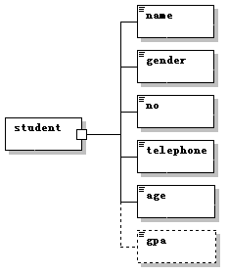
3.1.2 A Simple Example
student.xsd
  With the suffix with .xsd
  Is a special XML document
Loot at the root element and the Namespace

Slide 5
Instance Document and XSD
<?xml version="1.0" encoding="UTF-8"?>
<student>
<name>XiaoWang</name>
<gender>male</gender>
<no>123</no>
<telephone>010-12345678</telephone>
<gpa>80</gpa>
</student>
<?xml version="1.0" encoding="UTF-8"?>
<student xsi:noNamespaceSchemaLocation="student.xsd"
xmlns:xsi="http://www.w3.org/2001/XMLSchema-instance">
......
</student>

Slide 6
The comment element in XML Schema
xsd:annotation
  xsd:annotation element can contain comment text, and can contain two sub-element xs:appinfo and xs:documentation,which are the only two elements having mixture content model
xs:appinfo is used to comment the content which can be understood by the computer or program
Xs:documentation is used to comment the content which is read by the developer

Slide 7
Namespace
Why you need namespaces
What namespaces are, conceptually, and how they solve the problem of naming clashes
❑ The syntax for using namespaces in XML documents
❑ What is a URI, a URL, and a URN

Slide 8
3.2 Data Type in XML Schema
Element is the most important part.
  A XML document may have no any attribute or text, but it must contain one or more element (The root element at least)
Data Type is actual to define the structure or content model of the element

Slide 9
Data Type
  Simple Data Type
  It has no any sub-element nor attribute, in other words, the element with simple data type can have only text, or empty element without attribute
  Complex Data Type
  It has sub-elements and/or attributes, which is declared in the definition of the data type
<lastname> Jack </lastname>
<description/>
<product pid="1345"/>
<food type="dessert">Ice cream</food>

Slide 10
remark
Simple element has only “text”, but Complex element has sub-elements and/or attribute and text
In xml, “text” not refers to the string, but is one of the 44 simple data type, or the inherent of the simple data type
<xsd:element name=“orderid” type=“xsd:integer”/>。
<orderid>1032</orderid> corrent
<orderid>abc</orderid> wrong

Slide 11
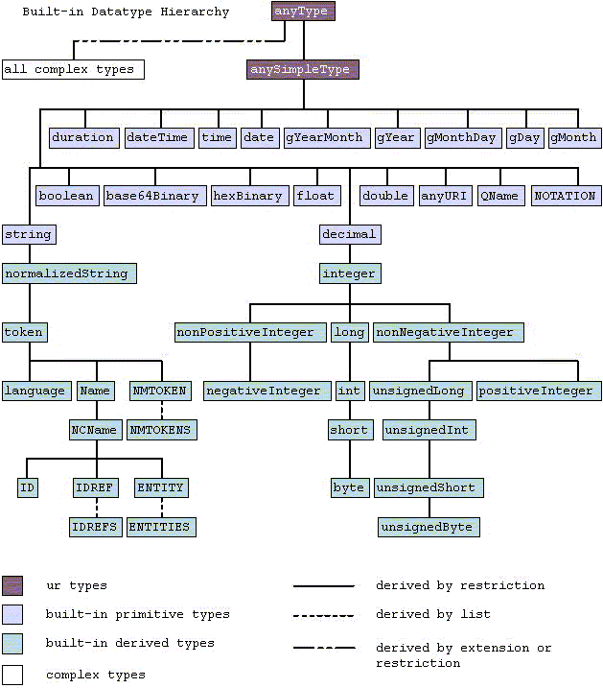

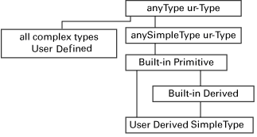
3.2.1 XML Schema Build-in Data Type

Slide 12
Usual Data Type related to String
String Family
string | Any string，including blank character (space, LF, CR, Tab)
normalizedString | normalizedString is an inherent of String，except the blank character
token | token is also an inherent of String, except the blank character occurrence at the beginning or ending, or the continual blank character
language | Is an inherent of String, refers to legal language id
Name | Is an inherent of String, refers to legal XML name, including the prefix of Namespace
NCName | Is an inherent of String, refers to legal XML name, excluding the prefix of Namespace
ID、IDREFS、 NMTOKEN | Which are coming from DTD，and have the similar semantic with DTD
... | ...

Slide 13
Usual Data Type related to Number
Number Family
float | IEEE single-precision number with 32bit
decimal | IEEE double-precision number with 32bit
integer | integral number Inherent from decimal
long | Integral number inherent from integer，with minimum value -9223372036854775808, with maximum value 9223372036854775807
int | Integral number inherent from long，with minimum value-2147483648, with maximum value 2147483647
nonPositiveInteger | Integral number inherent from integer，non greater than 0
... | ...

Slide 14
Usual Data Type related to Date/Time
Date、Time
date | Refers to one day, with format YYYY-MM-DD，YYYY refers to year；MM refers to month；DD refers to day。 Data Type Definition: <xsd:element name="start" type="xsd:date"/>， Related element can be <start>2002-09-24</start>。
time | Refers to a time, with format hh:mm:ss，hh refers to hour；mm refers to minute；ss refers to second。 Data Type definition : <xsd:element name="start" type="xsd:time"/>， Related element can be <start>09:00:00</start>。
datetime | Ref to one day and the detail time，with format YYYY-MM-DDThh:mm:ss。Data Type Definition: <xsd:element name="startdate" type="xsd:dateTime"/>， Related element can be <startdate>2002-05-30T09:00:00</startdate>。
duration | Refers to a time interval with format PnYnMnDTnHnMnS，P refers the interval；nY refers to year；nM refers to month； and so on 。
boolean | Refers true or false。Legal value list：true、false、1（ true）、0（false）。
base64Binary、hexBinary | Binary system data Hexadecimal system data
anyURI | Refers to an URI, in which the blank character is replaced by %20

Slide 15
3.2.2 to Inherent from the simple Data Type
The 44 simple data type is not enough
  How to express an email address
  How to express a telephone number
XML Schema provides mechanisms to define your own simple/complex data type, to extends the data type by custom
We can use restriction, List and union to define our own simple data type

Slide 16
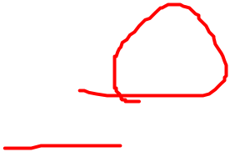
1. Derive new simple data type by Restriction
One named simple data type
One anonymous simple data type
<xsd:simpleType name="SimpleTypeName">
<xsd:restriction base="BaseType">
... facets descriptions ...
</xsd:restriction>
</xsd:simpleType>
<xsd:simpleType>
<xsd:restriction base="BaseType">
... facets descriptions ...
</xsd:restriction>
</xsd:simpleType>

Slide 17
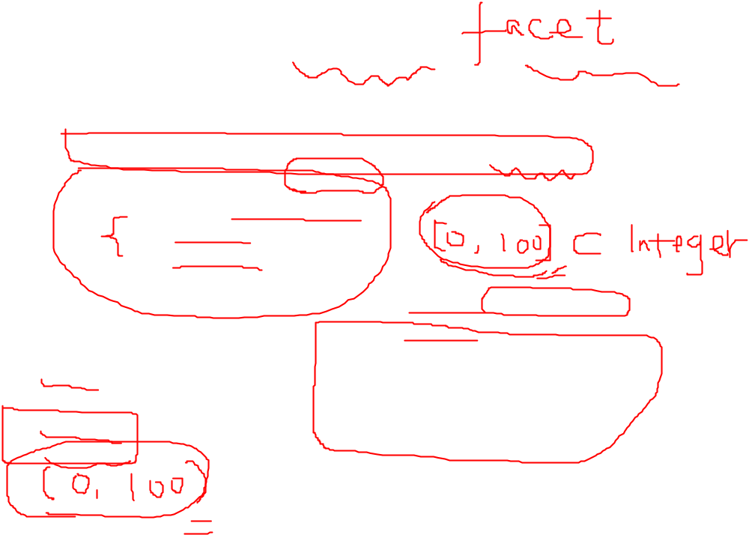
a). Setting the maximum or minimum to limit the number type
<xsd:element name="MyIntegerElement" type="MyInteger"/>
<xsd:simpleType name="MyInteger">
<xsd:restriction base="xsd:integer">
<xsd:minInclusive value="0"/>
<xsd:maxInclusive value="100"/>
</xsd:restriction>
</xsd:simpleType>
<xsd:element name="MyIntegerElement">
<xsd:simpleType>
<xsd:restriction base="xsd:integer">
<xsd:minInclusive value="0"/>
<xsd:maxInclusive value="100"/>
</xsd:restriction>
</xsd:simpleType>
<xsd:element>
minInclusive
maxInclusive
minExclusive
maxExclusive

Slide 18
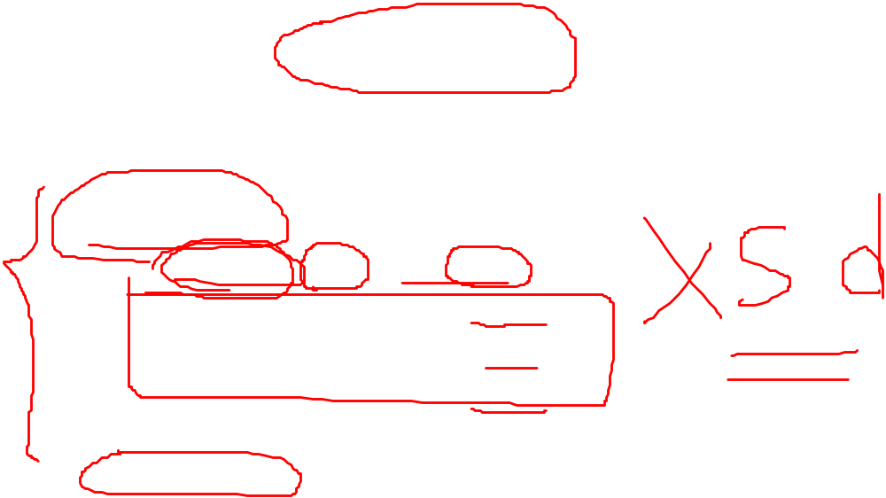
b). Setting enumeration values to limit the value space
<xsd:simpleType>
<xsd:restriction base="xsd:string">
<xsd:enumeration value="Audi"/>
<xsd:enumeration value="Golf"/>
<xsd:enumeration value="BMW"/>
</xsd:restriction>
</xsd:simpleType>
The basic data type is xsd:string，with xsd:enumeration, we can list the candidate legal values

Slide 19
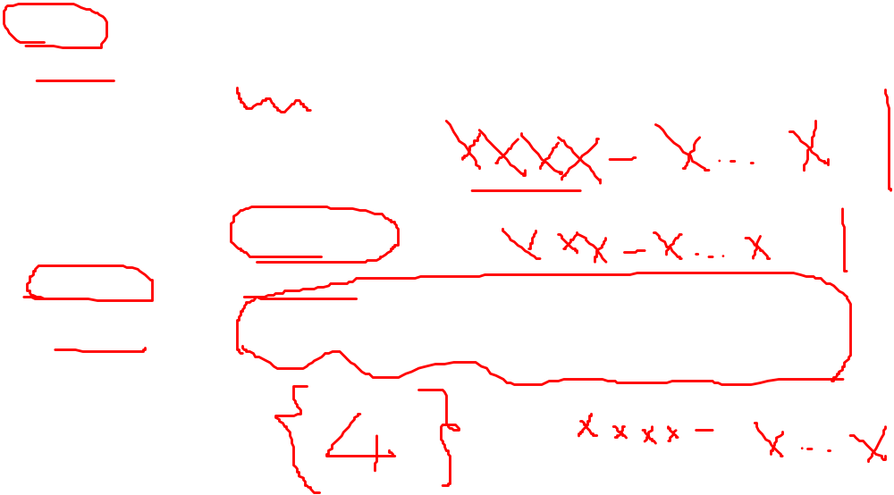
c). Setting a regular expression to limit the data pattern
<xsd:simpleType>
<xsd:restriction base="xsd:string">
<xsd:pattern value="[a-z]"/>
</xsd:restriction>
</xsd:simpleType>
<xsd:simpleType name="Telephone">
<xsd:restriction base="xsd:string">
<xsd:pattern value="(\d{4}-\d{8})|(\d{3}-\d{8})|(\d{4}-\d{7})"/>
</xsd:restriction>
</xsd:simpleType>

Slide 20
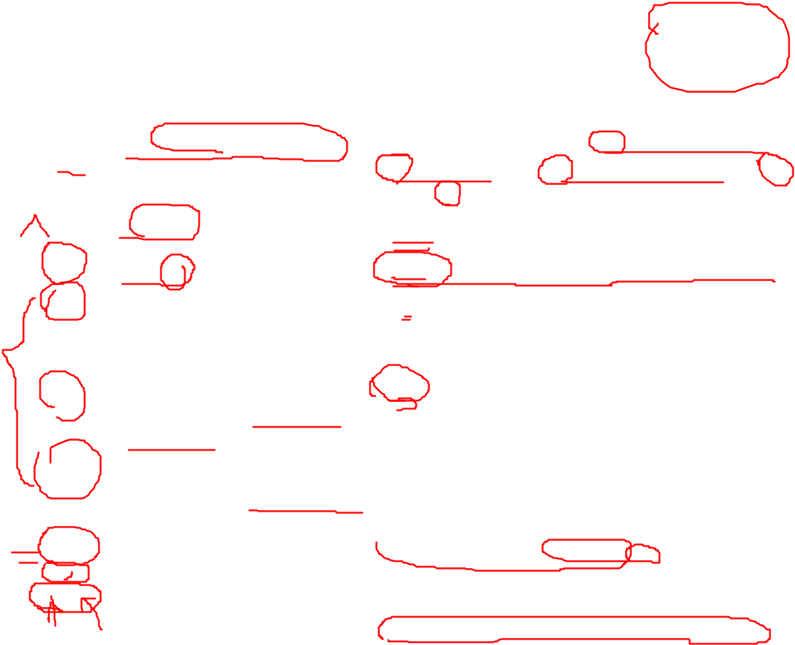
Different Meta Character in regular expression
symbol | Description | Simple examples
\ | Escaped/transferred meaning | \n means new line \x0a，\f means new page \0x0c，\t means tab \x09，\r means enter key \x0d，\\ means \。
^ | Line head | ^Hello matches the string which begins with Hello
$ | Line tail | done$ matches the string which ends with done。
* | The character/expression, in front of which matches 0 or more times | zo* matches both "z" and "zoo"。* equals in expression {0,}。
+ | The character/expression, in front of which matches 1 or more times | zo+ matches “zo” and "zoo"，but not match "z"。+ equals in expression {1,}。
? | The character/expression, in front of which matches 0 or 1 time | do(es)? Matches "do" and "does"。? Equals in exprssion {0,1}。
{n} {n,} {n,m} | n and m are both not negative integer，which means the minimum and maximum times | o{2} matches two continual o（like "food"）。 o{2,} matches two or more continual o (like "fooood“) o{1,3} matches 1-3 continual o （like "fod"、"food"）

Slide 21
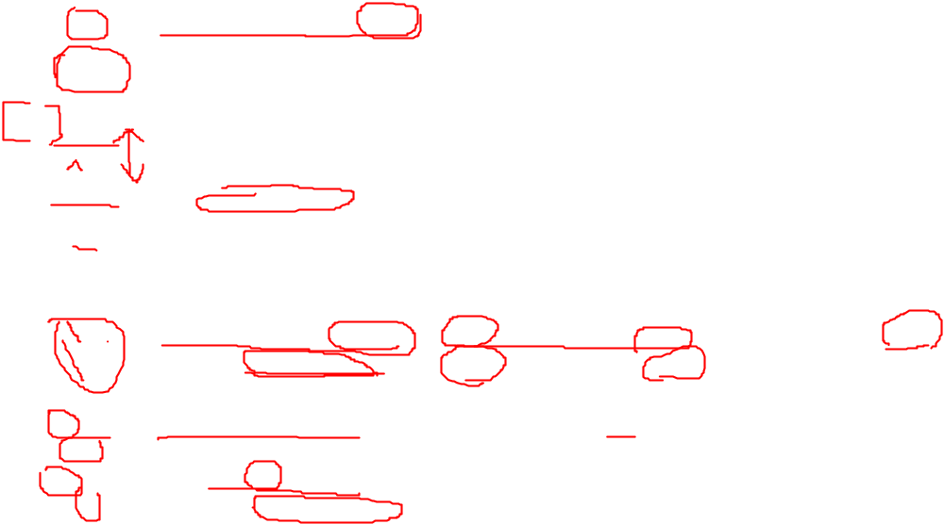
symbol | Description | Simple examples
. | Matches any character except "\n" | f.*d matches any string which contains f and d（no mater what is the content between this two characters），like "friend"。
x|y | Matches x or y。 | z|food matches "z" or "food"，but '(z|f)ood' matches "zood" or "food"。
[xyz] | matches any character in the character set | [abc] matches a or b or c
[^xyz] | Matches any character not in the character set | [^abc] matches any character except a,b, and c
[a-z] | Matches any character in the character scope | [a-z] matches any character between 'a' and 'z'
[^a-z] | Matches any character not in the character scope | [a-z] matches any character not between 'a' and 'z'
\b \B | Matches the boundary of one word Matches the non-boundary of one word | 'er\b' matches the ‘er’ in "never"‘,but not match the ‘er’ in "verb" 'er\B' not match the ‘er’ in "never"‘,but matches the ‘er’ in "verb"
\d \D | Matches a number character Matches a non-number character | equals to expression [0-9]。 Equals to expression [^0-9]。
\s \S | Matches any blank character Matches any non-blank character | Equals to expression [\n\r\t\0x20] Equals to expression [^\n\r\t\0x20]。
\w \W | Matches any word character including underline Matches any non-word character | Equals to expression [A-Za-z0-9_ ]。 Equals to expression[^A-Za-z0-9_ ]。

Slide 22
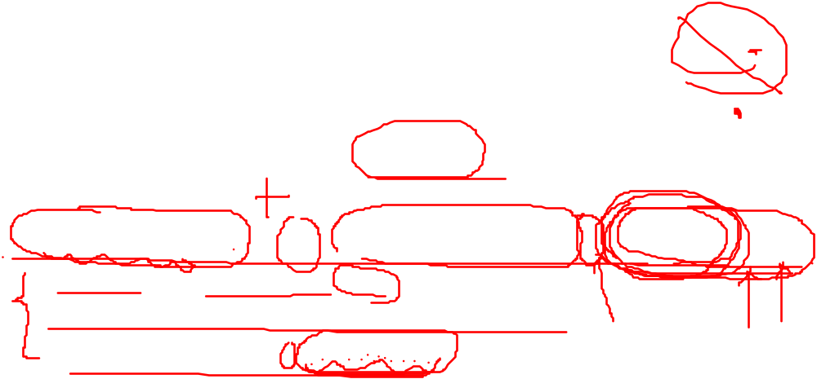
Usage of regular expression
We want to construct an email like data type, to valid the email element is legal：
So many editor（like EditPlus、Word）can search the content with regular expression as a condition
Java provides package java.util.regex，to support object-oriented text process
([a-zA-Z0-9_\-\.]+)@([a-zA-Z0-9_\-\.]+)\.([a-zA-Z]{2,5})
somthing@someserver.com
firstname.lastname@mailserver.domain.com somename@server.domain-com
Please refer to http://regexlib.com

Slide 23

d). Limit the length of the string content
length、maxLength and minLength
<xsd:simpleType>
<xsd:restriction base="xsd:string">
<xsd:length value="8"/>
</xsd:restriction>
</xsd:simpleType>
<xsd:simpleType>
<xsd:restriction base="xsd:string">
<xsd:minLength value="5"/>
<xsd:maxLength value="8"/>
</xsd:restriction>
</xsd:simpleType>

Slide 24
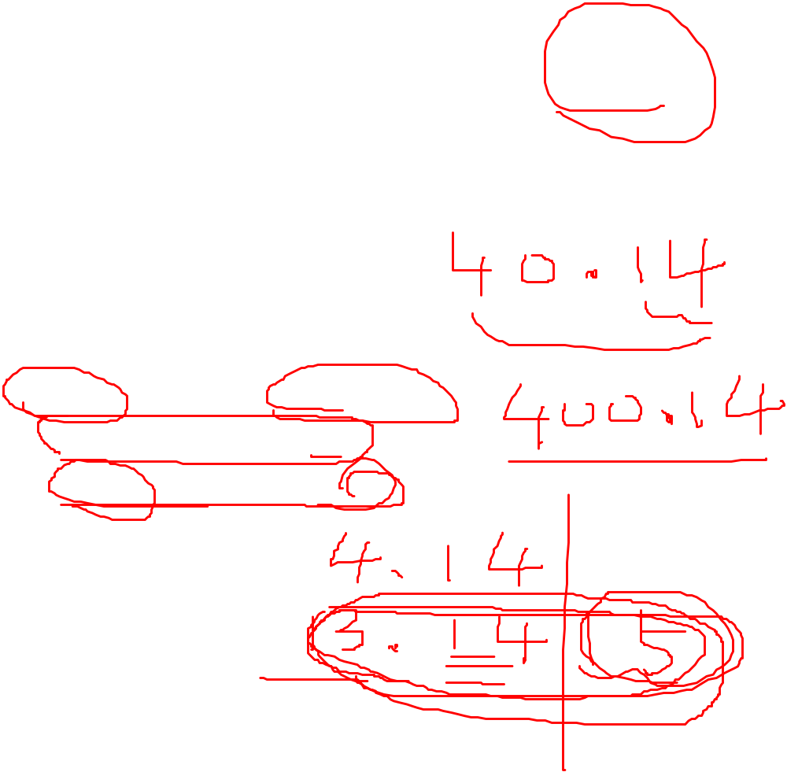
e). Limit the precision of the number content
totalDigits and fractionDigits
<xsd:simpleType>
<xsd:restriction base="xsd:decimal">
<xsd:totalDigits value="4"/>
<xsd:fractionDigits value="2"/>
</xsd:restriction>
</xsd:simpleType>

Slide 25
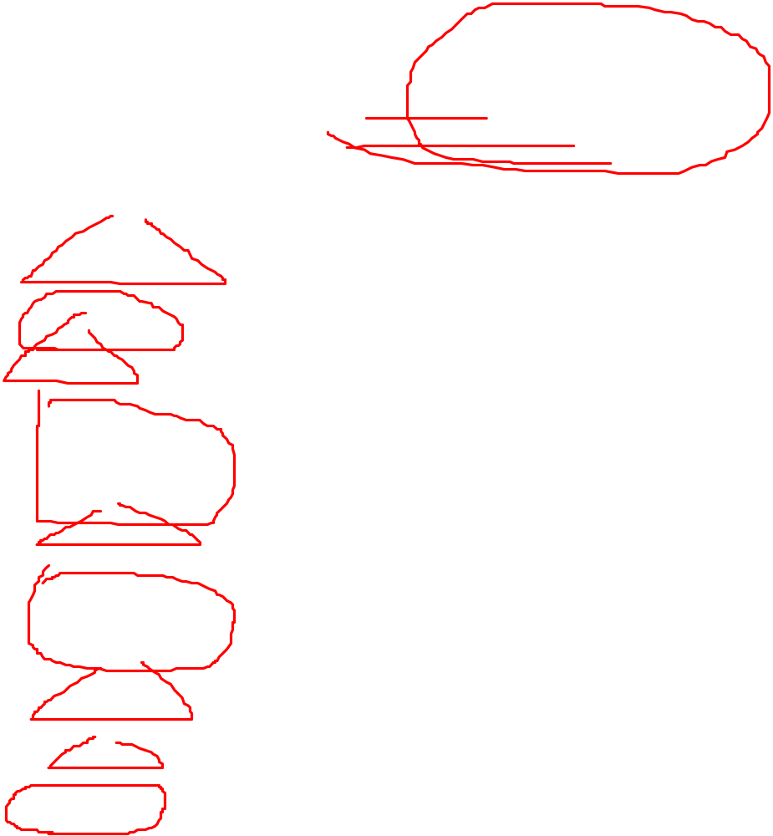
Different Restriction Facet
facet | description
enumeration | Define a group of legal candidate value
fractionDigits | Define the max length of the fractional part
length | Define the length of the string or the list
maxExclusive | Define the upper limitation of the number (which is less than the number)
maxInclusive | Define the upper limitation of the number （which is less than or equal to the number）。
maxLength | Define the maximum length of the string or the list
minExclusive | Define the lower limitation of the number（which is greater than the number）。
minInclusive | Define the lower limitation of the number（which is greater than or equal tothe number）
minLength | Define the minimum length of the string or the list
pattern | Define a regular expression, to match legal string
totalDigits | Define the max length of the integer and fractional part
whiteSpace | Define the blank character（CR、LF、Space and Tab）。

Slide 26
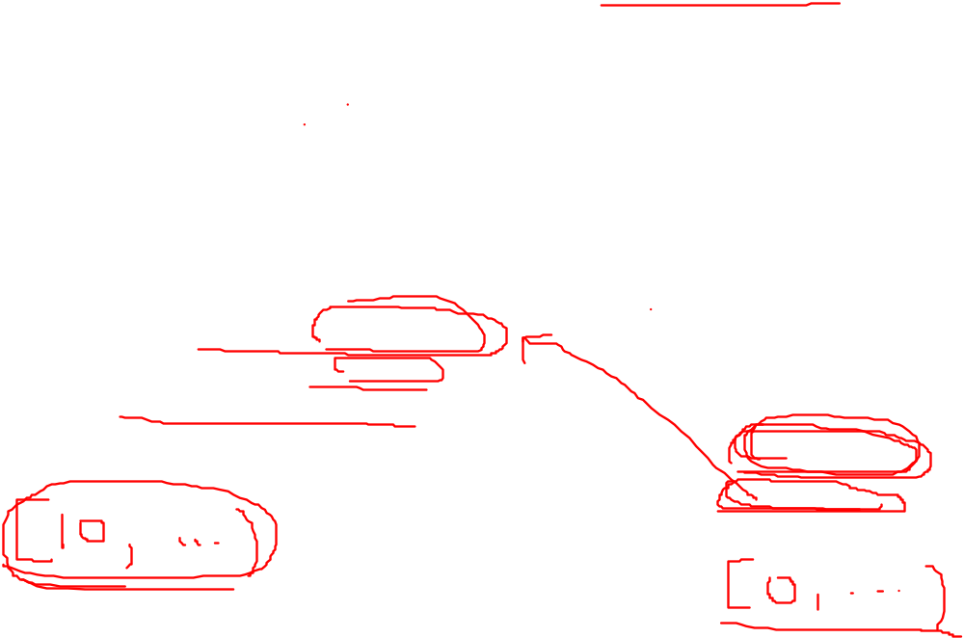
Comment about the derived simple data type through Resctriction
①.Need to satisfy the value space
②.Not allow to extend the value space of the basic data type
<xsd:simpleType>
<xsd:restriction base="xsd:int">
<xsd:totalDigits value="1"/>
<xsd:minInclusive value="10"/>
<xsd:maxInclusive value="100"/>
</xsd:restriction>
</xsd:simpleType>
<xsd:simpleType name="minInclusive">
<xsd:restriction base="xsd:float">
<xsd:minInclusive value="10"/>
</xsd:restriction>
</xsd:simpleType>
<xsd:simpleType name="minInclusive2">
<xsd:restriction base="minInclusive">
<xsd:minInclusive value="0"/>
</xsd:restriction>
</xsd:simpleType>

Slide 27
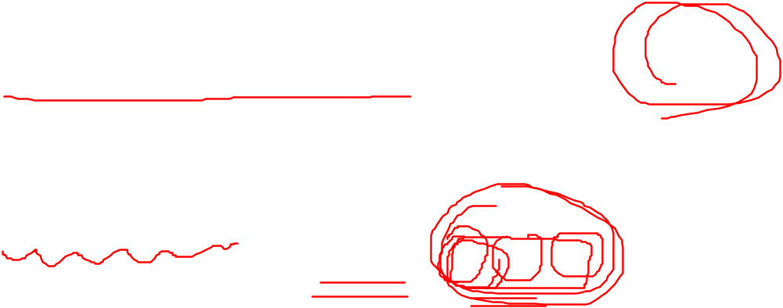
2. Derive new simple data type by List
Whether we can express a element which is a list of sub-element, like
Deriving by list is to construct an element, which is a list of a basic data type sub-element
<MyIntegers>100 101 102</MyIntegers>

Slide 28
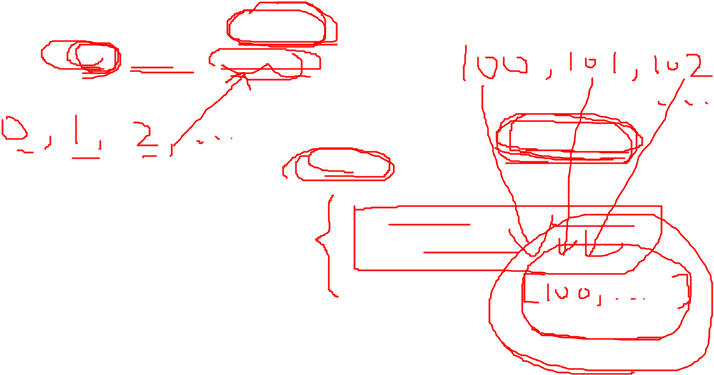
Example 1
<xsd:simpleType name="integerList">
<xsd:list itemType="xsd:integer"/>
</xsd:simpleType>
<xsd:simpleType name="myIntegerList">
<xsd:list>
<xsd:simpleType>
<xsd:restriction base="xsd:integer">
<xsd:minInclusive value="100"/>
</xsd:restriction>
</xsd:simpleType>
</xsd:list>
</xsd:simpleType>

Slide 29
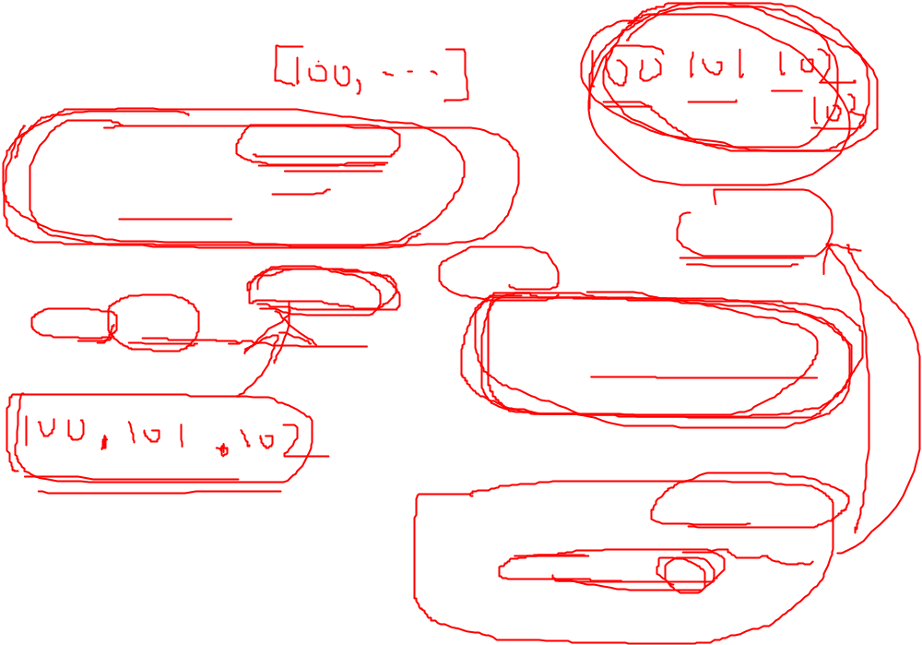
Example 2
<xsd:simpleType name="integerGE100">
<xsd:restriction base="xsd:integer">
<xsd:minInclusive value="100"/>
</xsd:restriction>
</xsd:simpleType>
<xsd:simpleType name="myIntegerList">
<xsd:list itemType="integerGE100"/>
</xsd:simpleType>
<xsd:simpleType name="myIntegerList">
<xsd:list>
<xsd:simpleType>
<xsd:restriction base="xsd:integer">
<xsd:minInclusive value="100"/>
</xsd:restriction>
</xsd:simpleType>
</xsd:list>
</xsd:simpleType>
<xsd:simpleType name="FourIntegerList">
<xsd:restriction base="myIntegerList">
<xsd:length value="4"/>
</xsd:restriction>
</xsd:simpleType>

Slide 30
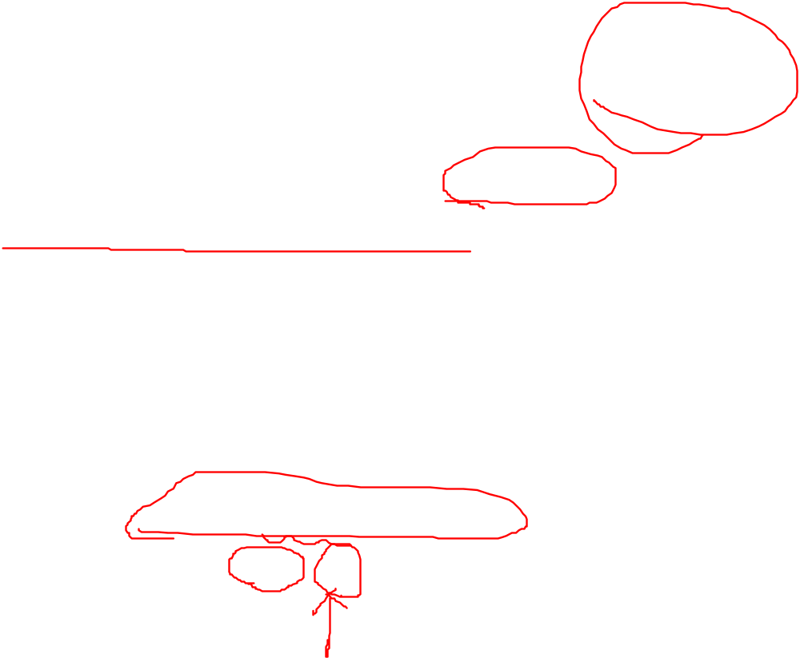
3. Derive new simple data type by Union
Deriving by list makes the sub-element in the list the same basic data type, how about the sub-elements have different basic data types
Given that a element named student has 3 course score, such as main language, math language, English language,like
<student1>70 80 90</student1>
<student2>70 80 N/A</student2>

Slide 31
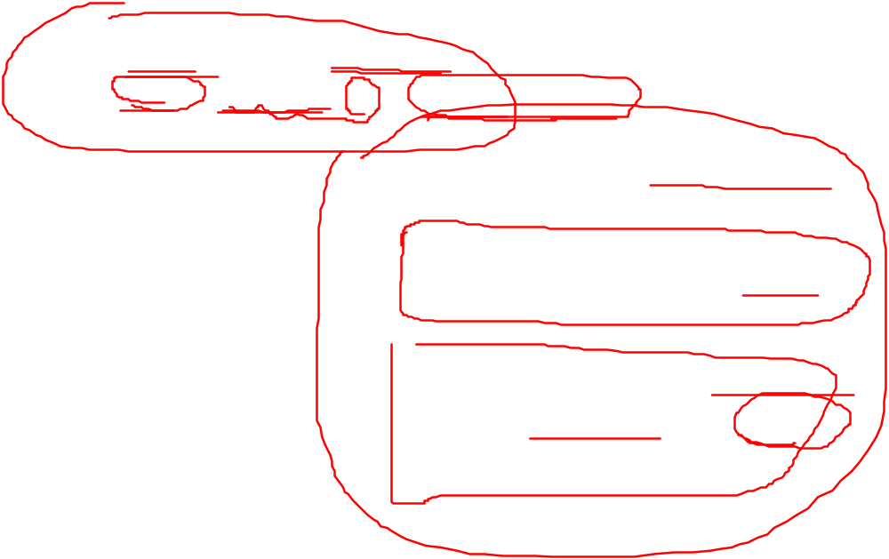
example
<xsd:simpleType name="integerOrDate">
<xsd:union memberTypes="xsd:integer xsd:date"/>
</xsd:simpleType>
<xsd:simpleType name="myIntegerUnion">
<xsd:union>
<xsd:simpleType>
<xsd:restriction base="xsd:integer"/>
</xsd:simpleType>
<xsd:simpleType>
<xsd:restriction base="xsd:string">
<xsd:enumeration value="N/A"/>
</xsd:restriction>
</xsd:simpleType>
</xsd:union>
</xsd:simpleType>

Slide 32
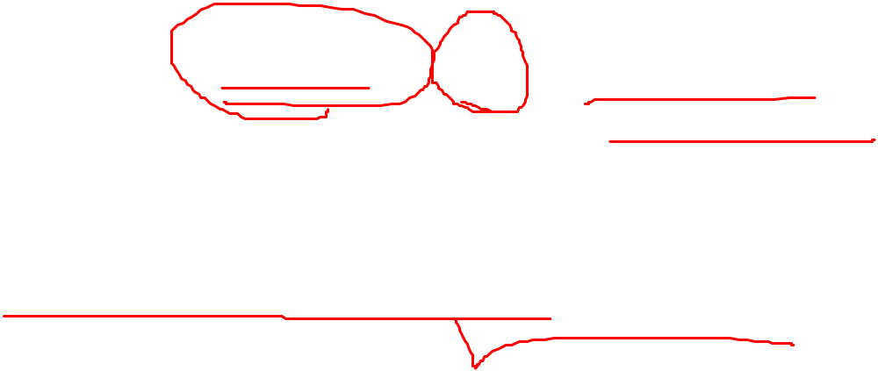
3.2.3 complex data type
A named complex data type
A anonymous complex data type
<xsd:complexType name="ComplexTypeName">
......
</xsd:complexType>
<xsd:complexType>
......
</xsd:complexType >

Slide 33
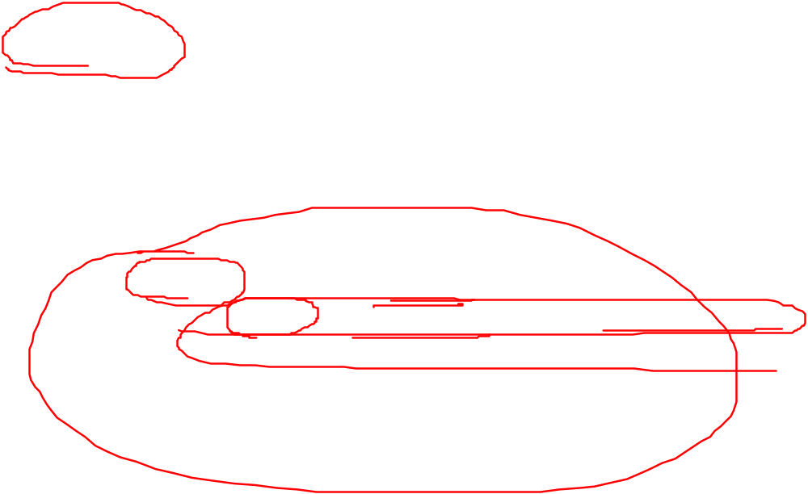
Case 1. Empty element（contains only attribute, not contain sub-element or text）
The definition is so simple that, it only need to define the attribute and its data type
<xsd:complexType name="ComplexType">
<xsd:attribute name="Att1Name" type="someSimpleType1"/>
<xsd:attribute name="Att2Name" type="someSimpleType2"/>
......
</xsd:complexType>

Slide 34
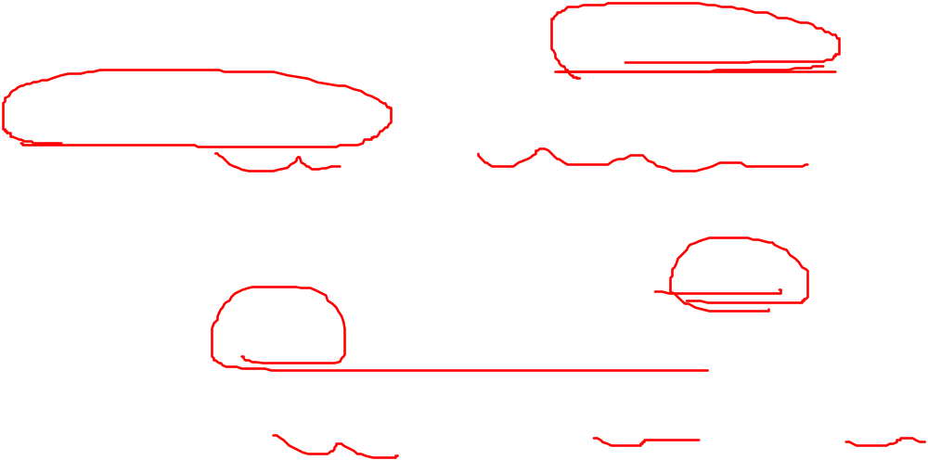
Case 2. contains only sub-element and/or attribute, not contain text
XML Schema provides more container to express the order of the sub-element,
They are xsd:sequence、xsd: choice、xsd:all。

Slide 35
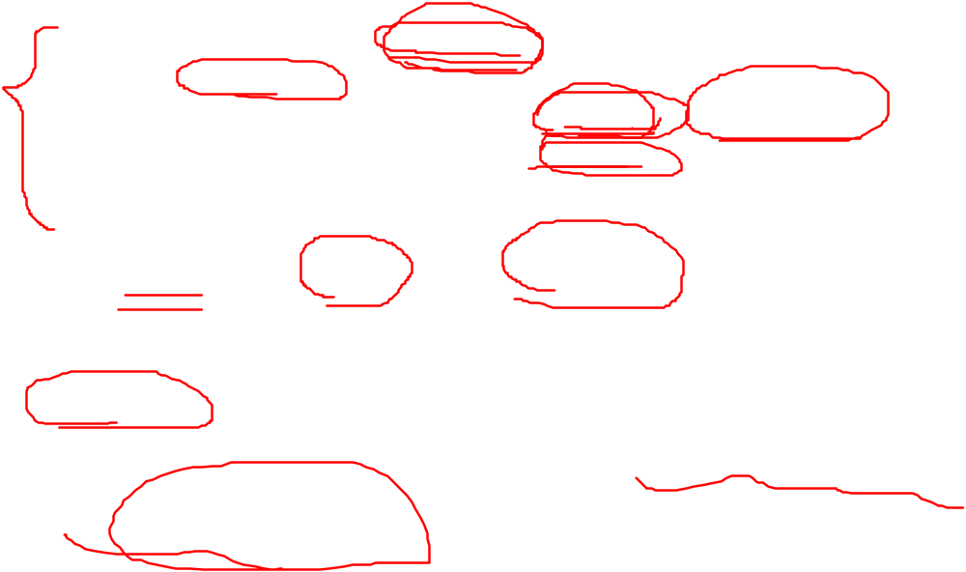
xsd:sequence
Means sequence，the elements should occure by the declared order
<xsd:complexType name="studentType">
<xsd:sequence>
<xsd:element name="firstname" type="xsd:string"/>
<xsd:element name="lastname" type="xsd:string"/>
</xsd:sequence>
</xsd:complexType>
<xsd:element name="student" type="studentType"/>
The element should be declared in one container, but can not occur in xsd:complexType directly，even there is only one sub-element

Slide 36
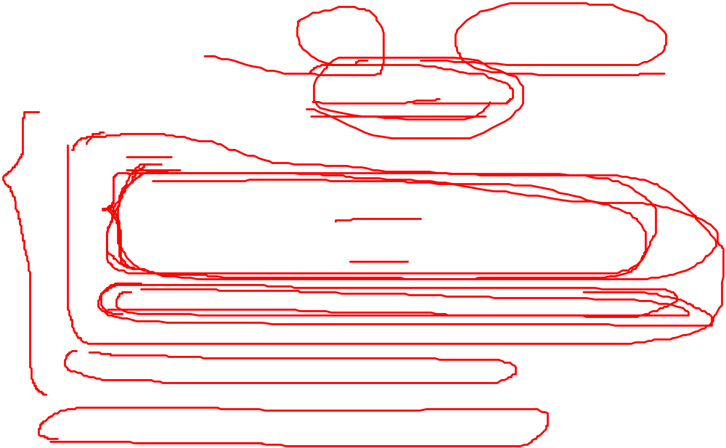
xsd: choice
Means to choose one from the content
<xsd:complexType name="PurchaseOrderType">
<xsd:sequence>
<xsd:choice>
<xsd:sequence>
<xsd:element name="shipTo" type="USAddress"/>
<xsd:element name="billTo" type="USAddress"/>
</xsd:sequence>
<xsd:element name="singleUSAddress" type="USAddress"/>
</xsd:choice>
<xsd:element name="items" type="Items"/>
</xsd:sequence>
<xsd:attribute name="orderDate" type="xsd:date"/>
</xsd:complexType>
<xsd:element name="PurchaseOrder" type="PurchaseOrderType"/>

Slide 37
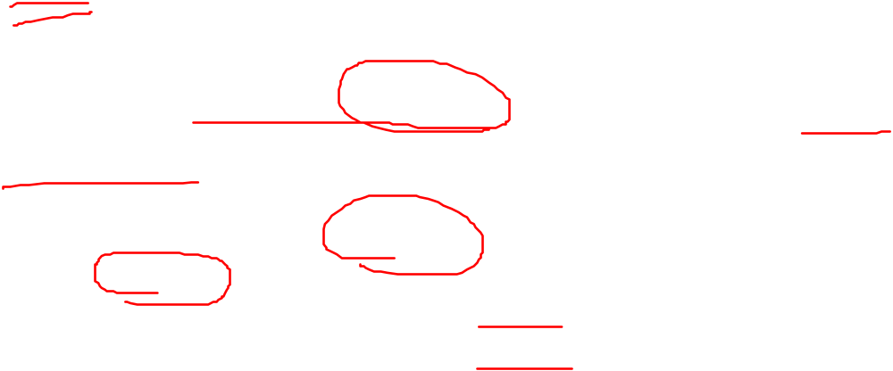
xsd:all
Means there is no order about the sub-element
<xsd:complexType name="studentType">
<xsd:all>
<xsd:element name="firstname" type="xsd:string"/>
<xsd:element name="lastname" type="xsd:string"/>
</xsd: all>
</xsd:complexType>
<xsd:element name="student" type="studentType"/>

Slide 38
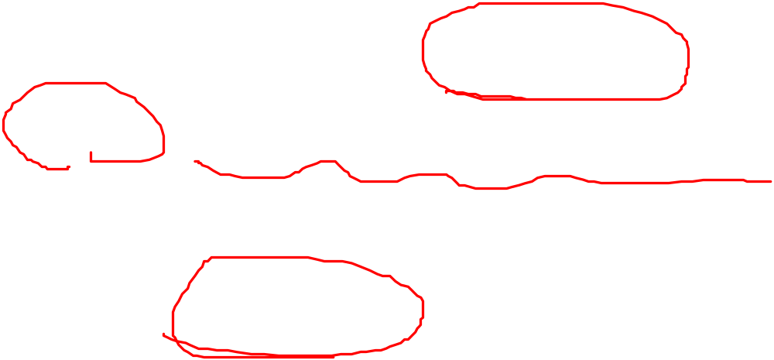
Case 3. contains only attribute and text, not contain sub-element
We can declare this kind of data type with key word “simpleContent”

Slide 39
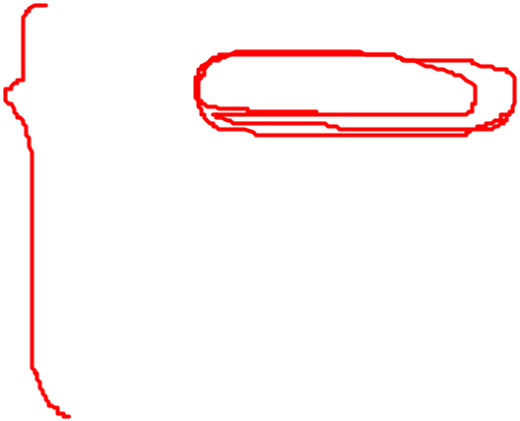
example
method I | method II
<xsd:element name="ele_name"> <xsd:complexType> <xsd:simpleContent> <xsd:extension base="basetype"> ...... </xsd:extension> </xsd:simpleContent> </xsd:complexType> </xsd:element> | <xsd:element name="ele_name"> <xsd:complexType> <xsd:simpleContent> <xsd:restriction base="basetype"> ...... </xsd: restriction> </xsd:simpleContent> </xsd:complexType> </xsd:element>

Slide 40
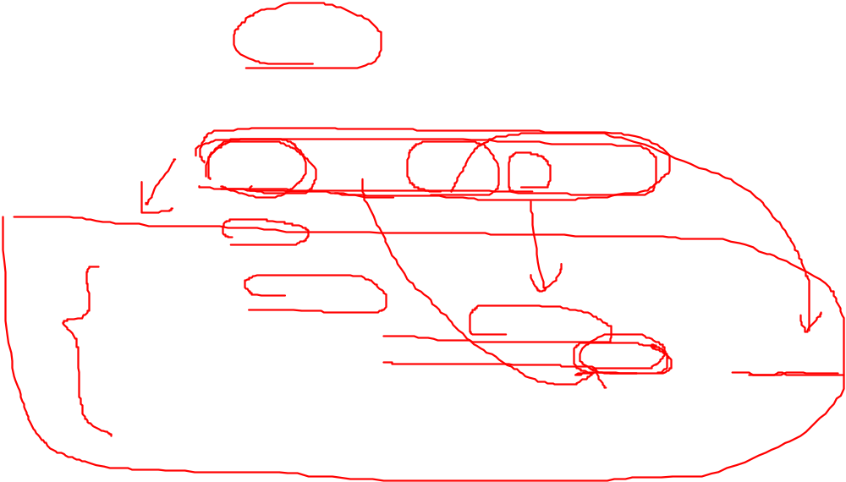
example
Element shoesize has only attribute country and text content（the detail value of shoesize ）：
<shoesize country="france">35</shoesize>
<xsd:element name="shoesize">
<xsd:complexType>
<xsd:simpleContent>
<xsd:extension base="xsd:integer">
<xsd:attribute name="country" type="xsd:string"/>
</xsd:extension>
</xsd:simpleContent>
</xsd:complexType>
</xsd:element>

Slide 41
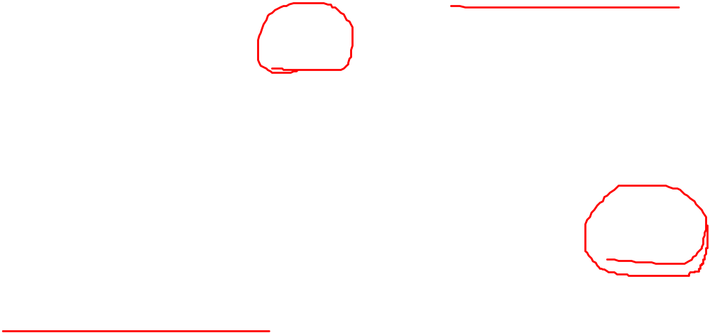
Case 4. contain both sub-element and text string
Similar to DTD, we can name the content in the xml as mixture content
We should use the attribute mixed in complexType 。

Slide 42
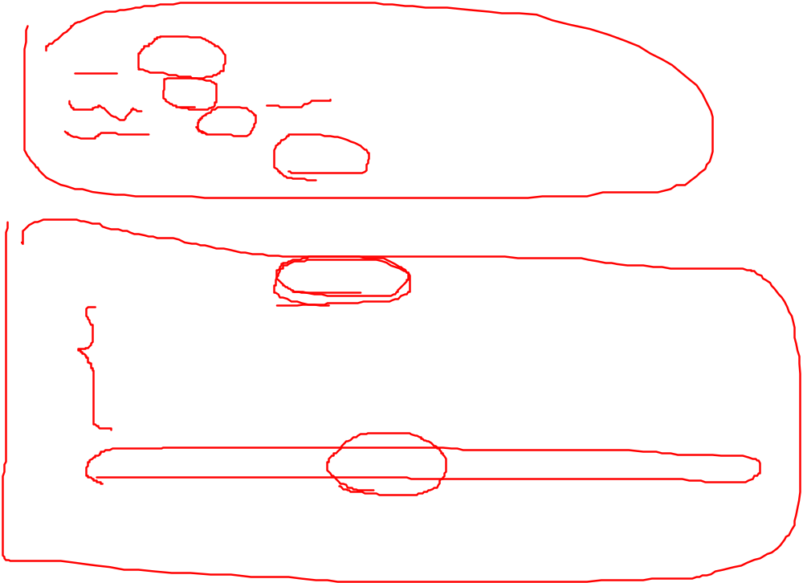
example
<letter letter_id="123">
Dear Mr.<name>John Smith</name>.
Your order <orderid>1032</orderid>
will be shipped on <shipdate>2007-07-13</shipdate>.
</letter>
<xsd:element name="letter">
<xsd:complexType mixed="true">
<xsd:sequence>
<xsd:element name="name" type="xsd:string"/>
<xsd:element name="orderid" type="xsd:positiveInteger"/>
<xsd:element name="shipdate" type="xsd:date"/>
</xsd:sequence>
<xsd:attribute name="letter_num" type="xsd:positiveInteger"/>
</xsd:complexType>
</xsd:element>

Slide 43
3.2.4 the complete declaration grammar about the data type
The introduction above declare how to declare simple or complex data type with a simple grammar
<xsd:simpleType name="simpleTypeName">
......
</xsd: simpleType>
以及：
<xsd:complexType name="complexTypeName">
......
</xsd:complexType>

Slide 44
3.2.4.1 attributes in simpleType element
<simpleType
final = (#all | List of (list | union | restriction))
id = ID
name = NCName>
Content: (annotation?, (restriction | list | union))
</simpleType>
final
define the not-allowed operation list
#all
define the simple can not be deprived again

Slide 45
3.2.4.2 attributes in complexType element
<complexType
abstract = boolean : false
block = (#all | List of (extension | restriction))
final = (#all | List of (extension | restriction))
id = ID
mixed = boolean : false
name = NCName>
Content: (annotation?, (simpleContent | complexContent |
((group | all | choice | sequence)?, ((attribute | attributeGroup)*, anyAttribute?))))
</complexType>
abstract
Means whether it is a virtual basic data type, and whether can be the parent of another data type。

Slide 46
3.3 Declarations about elements and attributes
This chapter introduces the whole declaration about element and attribute
What is the difference on Global and Local
  The children of the root element “xsd:schema” is global data type or element。
The global object should be the declaration of the element or data type

Slide 47
3.3.1 declaration about element
Define a named data type firstly
Declare an element binding the data type by name
<xsd:simpleType or xsd:complexType ...... name="ele_type">
......
</xsd:simpleType or xsd:complexType>
<xsd:element name="ele_name" type="ele_type"/>
Or declare an element and define the anonymous data type build-in at the same time
<xsd:element name="ele_name">
<xsd:simpleType or xsd:complexType>
......
</xsd:simpleType or xsd:complexType>
</xsd:element>

Slide 48
3.3.1.1 attributes to the element
<element
abstract = boolean : false
block = (#all | List of (extension | restriction | substitution))
default = string
final = (#all | List of (extension | restriction))
fixed = string
form = (qualified | unqualified)
id = ID
maxOccurs = (nonNegativeInteger | unbounded) : 1
minOccurs = nonNegativeInteger : 1
name = NCName
nillable = boolean : false
ref = QName
substitutionGroup = QName
type = QName>
Content: (annotation?, ((simpleType | complexType)?, (unique | key | keyref)*))
</element>

Slide 49

1. maxOccurs and minOccurs
This two attributes are used to limit the maximum or minimum number of the restricted element
<?xml version="1.0" encoding="UTF-8"?>
<xsd:schema xmlns:xsd="http://www.w3.org/2001/XMLSchema">
<xsd:element name="book">
<xsd:complexType>
<xsd:sequence>
<xsd:element name="title" type="xsd:string"/>
<xsd:element name="author" type="xsd:string"
minOccurs="1" maxOccurs="3"/>
<xsd:element name="price" type="xsd:decimal"/>
</xsd:sequence>
</xsd:complexType>
</xsd:element>
</xsd:schema>
Set maxOccurs="unbounded“, to let the element occur more than 1 time

Slide 50
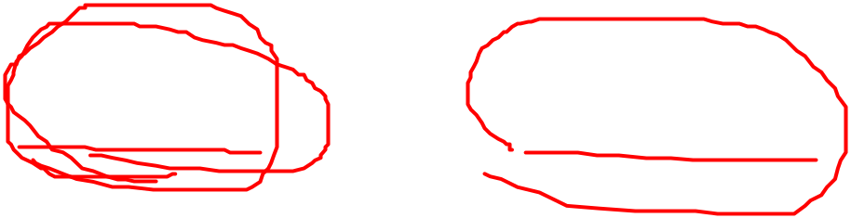
2. default and fixed
default means the initial value
Fixed means the final value which can not be changed
The related element should be simple data type
<xsd:element name="test" type="xsd:string" fixed="fixedstring"/>

Slide 51
3. Attribute ref
Ref, which refers some declared global element
<xsd:element name="person">
<xsd:complexType>
<xsd:sequence>
<xsd:element name="firstname" type="xsd:string"/>
<xsd:element name="lastname" type="xsd:string"/>
</xsd:sequence>
</xsd:complexType>
</xsd:element>
<xsd:element name="employee">
<xsd:complexType>
<xsd:sequence>
<xsd:element name="ID" type="xsd:string"/>
<xsd:element ref="person"/>
</xsd:sequence>
</xsd:complexType>
</xsd:element>

Slide 52
4. nillable and xsi:nil
nillable=false means it doesn’t allow some element be empty；
nillable=true means it allows some element be empty
<xsd:element name="studentid" type="xsd:integer" nillable="true"/>
Should use the attribute xsi:nil in the xsi namespace
<studentid xsi:nil="true"></studentid>

Slide 53
3.3.1.2 unique, key and keyref in element
We can use unique、key and keyref to express the meaning of unique, primary key, foreign key semantics in RDBMS

Slide 54
1. unique
<unique id = ID name = NCName>
Content: (annotation?, (selector, field+))
</unique>
<selector id = ID xpath = a subset of XPath expression >
Content: (annotation?)
</selector>
<field id = ID xpath = a subset of XPath expression >
Content: (annotation?)
</field>
Notes:
每一个 field 元素均包含一个 XPath 表达式，指定对于由 selector 元素指定的元素集而言必须唯一的值（属性或元素值）。如果有多个 field 元素，则 field 元素的组合必须是唯一的。在此情况下，单个 field 元素的值对于选定元素不一定是唯一的，但所有字段的组合必须是唯一的。必须有一个或多个 field 元素。
selector 元素包含 XML 路径语言 (XPath) 表达式，指定一个元素集，在其中由 field 元素指定的值必须唯一。必须有一个且只有一个 selector 元素。

Slide 55
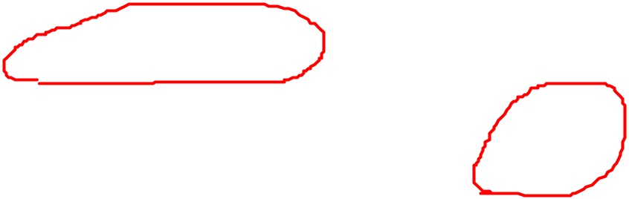
Example about Unique
unique.xsd
orderByCustomer.xml

Slide 56
2. key 和 keyref constraint
<key id = ID name = NCName>
Content: (annotation?, (selector, field+))
</key>
<keyref id = ID name = NCName refer = QName>
Content: (annotation?, (selector, field+))
</keyref>
Notes:
key 元素的结构和 unique 大致相同，它要求所选内容在指定范围内必须是唯一的，并且通过 name 属性指定键的名称，以便由 keyref 进行引用。keyref 元素中多了一个 refer 属性，该属性的值应该是一个 key 元素的名称，表示对该 key 元素的引用。key 和 keyref 之间的关系就是关系数据库中主键和外键之间的关系。

Slide 57
Example about RDBMS
cno | Cname | cpno | credit
1 | Database | 5 | 3
2 | Math |  | 4
3 | C program language |  | 3
4 | Operation system | 3 | 3
5 | Data structure | 3 | 3
Key.xsd

Slide 58
3.4.1 PSVI data model
Post Schema Validation Infoset
Notes:
XML Schema 所描述的数据模式不仅仅可用于对 XML 实例文档的数据进行有效性验证，而且在进行了验证之后，将在解析器中构成一颗新的 XML 文档树，其中每个节点将附加上 XML Schema 中所定义的具体类型，所得到的这种新的数据模型称为“经过 Schema 验证的信息集（Post Schema Validation Infoset，PSVI）”。
对于 XQuery、XPath 等查询任务、以及其他处理 XML 数据的应用程序而言，PSVI 是非常重要的。

Slide 59
3.4.2 the target namespace in XML Schema document
<xsd:schema xmlns:xsd=“http://www.w3.org/2001/XMLSchema” targetNamespace="http://www.xml.com" xmlns="http://www.xml.com" elementFormDefault="qualified" attributeFormDefault="unqualified"> ... </xsd:schema> Schema 文档 somexsd.xsd
<root xmlns="http://www.xml.com" xmlns:xsi="http://www.w3.org/2001/XMLSchema-instance" xsi:schemaLocation="http://www.xml.com http://somesite/somexsd.xsd"> ...... </root> sample

Slide 60
elementFormDefault
elementFormDefault’s sementics
whether | Value to the elementFormDefault | Global element or data type | Local element
No | qualified | No namespace | No namespace
 | unqualified | No namespace | No namespace
yes | qualified | targetnamespace | Target namespace
 | unqualified | targetnamespace | No namespace

Slide 61
attributeFormDefault
attributeFormDefault’s semantics
whether | Valut to the attributeFormDefault | attribute
No | qualified | No namespace
 | unqualified | No namespace
yes | qualified | targetnamespace
 | unqualified | No namespace

Slide 62
<?xml version="1.0" encoding="UTF-8"?>
<xsd:schema xmlns:xsd="http://www.w3.org/2001/XMLSchema"
elementFormDefault="unqualified"
attributeFormDefault="qualified" targetNamespace="ts">
<xsd:element name="root">
<xsd:complexType>
<xsd:sequence>
<xsd:element name="element_a" type="xsd:string"/>
<xsd:element name="element_b" type="xsd:integer"/>
</xsd:sequence>
<xsd:attribute name="att" type="xsd:string"/>
</xsd:complexType>
</xsd:element>
</xsd:schema>
<n1:root n1:att="String" xsi:schemaLocation="ts correct.xsd"
xmlns:xsi="http://www.w3.org/2001/XMLSchema-instance" xmlns:n1="ts">
<element_a>String</element_a>
<element_b>0</element_b>
</n1:root>

